Slide 1
BANK MANAGEMENT SYSTEM
SUBMITTED BY-Manjusha Ghuge
BATCH CODE:2020-6335
ENROLL NO-EBEON1021461109

Slide 2

INTRODUCTION
The Bank Management System is an application for maintaining a person’s Account in a bank.
This application give the access to customer to Create an account ,search account, deposit/withdraw the cash from an account. Which basically menu driven application.

Slide 3

Application Description
The program first asked how many account you want add and add the customer details according ,further displays series of menus to operate over accounts.
Main Menu
1. Display All
2. Search By Account
3. Deposit
4. Withdrawal
5.Exit
Ur Choice :

Slide 4
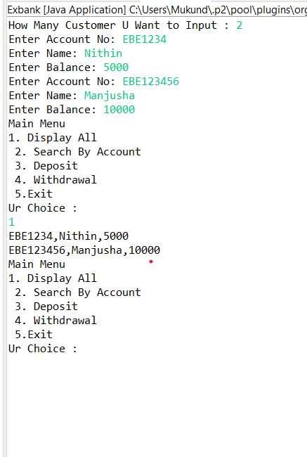
OUTPUT

Slide 5
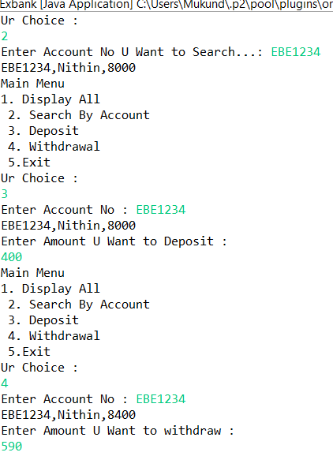
OUTPUT

Slide 6

THANK YOU

